Slide 1


Slide 2
Team MEMBERS
Girishkumar R
Gowtham R
Manimaran V
Mohammed Irfan S
Ponvizhi U
Project Duration in Days : 40
Pooja S
Sandhiya S
Sriram M
Venkateshwaran M

Slide 3
ABOUT THIS APPLICATION
Aspire Overflow is developed for the users inside our office.
The main purpose of this platform is to post your queries and to write articles, mostly about technologies.
Normal employee of the company will be the users.
Reviewer is an extra privilege given to the users. Reviewer is the one who reviews the articles.
Admin is another user who has the permission to verify the register user and allow the user to access the website.

Slide 4
EXISTING CHALLENGES in the Existing project.
Knowledge sharing will be very limited.
Learnings about the current technologies will not be up-to-date.
Problems and queries takes very much time to resolve.

Slide 5
SOLUTION and ARCHITECTURE
Creation of articles about the thing you want to share.
Posting the queries that you have problem with solving.
Answering the queries that you have knowledge of.

Slide 6
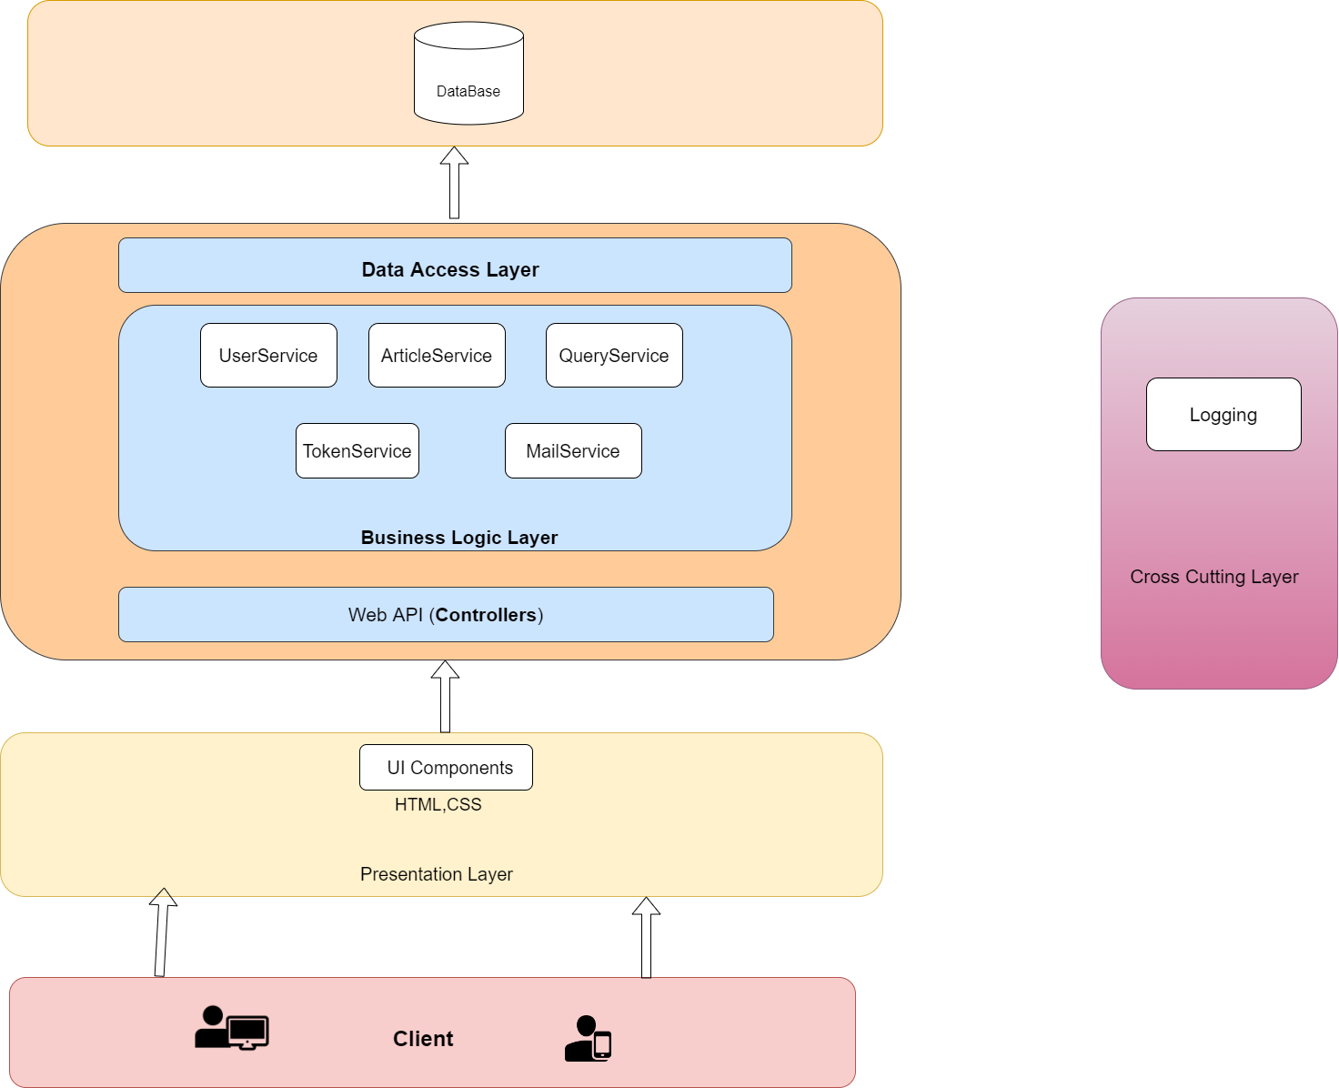

Slide 7
EXECUTION JOURNEY
Kick off and Brain stroming
User stories
Functional and Non-Functional Requirements
Wireframe
Data Model
High Level Design
Low Level Design
HTML Template
Angular Components
Estimation Calculation
Web Api
Integration
Unit Testing
Set-up Documentation
Code Review
SonarQube
Linting
Light House
Deployment in IIS
JMeter
Test Scenarios

Slide 8
Artifacts
Areas | Link
Requirement – User Stories, Wireframes, Data Flow | Wireframe and User Stories
Swagger - API | Api-Swagger
Data Model – EAR (Entity Attribute Relationship) | Data Model
Test Scenarios | Test Secarios
Sequence Diagrams | Sequence Diagarm
Defect Logs | Defect Logs
Code Quality Metrics | Sonar and Lint reports
Setup Manual | Setup Manual

Slide 9
TECHNOLOGIES , Tools & PLUGINS USED
Data Table – JQuery
Ck editor – Js
Dotnet Core 6.0
Angular 13
Visual Studio Code
Node js
Angular
SonarQube
SQL Server Management System
JMeter
Chart js

Slide 10
DEMO
Web Api - http://172.24.210.43/Aspire-API/swagger
Angular - http://172.24.210.43/AspireOverflow

Slide 11
LESSONS LEARNED
We need to understand the system of the project we are going to do.
Requirement gathering is the first-most thing to be done.
User-Stories should tell about the flow of the system.
The system should reflect the wireframe.
Set-up documentation should be written simple for the user manual.
Unused and Dead codes should be removed.
How to Manage the work with the available members.
To take ownership of our work.
Have to include the waiting time of the PAM request needed in the execution time.
Also need to think from the user perspective.

Slide 12
LESSONS LEARNED
Should follow all the code priciples.
Review your work before the meeting.
There is no 'me' in the teamwork.
Always track your timesheet.
Keep your work on track with your estimation process.
Work for 11hours a day.
Set context before staring your work.
Listen to every one's sugesstion in the group.
Learning should be grown and should not be stopped.
Don't stress and enjoy doing your work.

Slide 13
THANK YOU
By Team-Aurora

